Slide 1
05. Security in cloud computing

Slide 2
5.1] cloud security dundamentals : -
Cloud Security : -
i) cloud computing security consist of a set of policies, controls, procedures and technologies that work together to protect cloud based systems, data and infrastructure.
ii) It is a set of control-based safeguards and technology protec- tion designed to protect resources stored online from leakage, theft, or data loss.

Slide 3
Fundamentals of cloud storage : -
1. Understand what you're responsible for : - To ensure security, close customers need to double check with their Taas providers to understand who's in charge of each security control.
2. Control User Access : - Identity and access control policies should grant the minimum set of privileges needed and only grant other permissions as needed.
3. Data Protection : - Methods include virtual private networks, encryption, or masking. Data stored on cloud infrastructure should never be unencrypted.
4. Secure Credentials : - By maintaining strict access control, we can keep critical documents from malicious insiders or backers. with stolen credentials.
5. Implement MFA : - Organizations can significantly improve their security posture and protect sensitive data and applications.
6. Increase Visibility : - To see issues like unauthorized access attempts, turn on security logging and monitoring once your cloud has been setup.
7. Adopt a shift-left approach : - With a shift-left approach, security considerations are incorporated early into the development process rather than at the final stage.

Slide 4
5.2] cloud risk : -
i) Cloud Risk is the possibility of loss or harm arising from performing an activity.
ii) Cloud Risks is typically measured according to its threat level and the no. of possible or known vulnerabilities.

Slide 5
The most important classes of cloud specific risk are : -
1. Loss of Governance : - In using cloud infrastructure, the client necessarily cedes control to the cloud Provider (CP) on a number of issues which may affect security.
2. Lock-in : - There is currently little on offer in the way of tools, procedures or standard data formats or service interfaces that could guarantee data, application and service portability. This can make it difficult for the customer to migrate from one provider to another.
3. Isolation failure : - This risk category covers the failure of mechanisms separating storage, memory, routing and even reputation between different tenants (guest hopping attacks).
4. Compliance Risks : - Investment in achieving certification. (eg. industry standard) may be put at risk by migration to the cloud.
5. Data Protection : - cloud computing poses several data protection risks for cloud customers and providers. It may be difficult for the cloud customers to effectively check the data handling practices of the cloud provider.
6. Malicious Insider : - While usually less likely, the damage which may be caused by malicious insiders is often far greater cloud architectures necessitate certain roles which are extremely high-risk.

Slide 6
How to manage cloud security risks : -
1. Perform regular risk assessments to find new risks.
2 Prioritize and implement security controls to mitigate the risks. you've identified.
3. Document and revisit any risk you choose to accept.

Slide 7
5.3 cloud risk division : -
The risks identified in the assessment are classified into three categories namely Policy and organizational, Technical and legal.
1. Policy and organizational Risks : -
i) These are business related IT risks that organizations may face when considering cloud computing service providers.
ii) Such risks include lock-in, loss of governance, compliance. challenges, loss of business reputation, and cloud service termination or failure.

Slide 8
2. Technical Risks : - i) organizations that deploy cloud solutions also face Techni cal risks such as resource exhaustion, which can occur when not managing cloud resources effectively. ii) Resource exhaustion can cause degradation of services in some cases, a failure to provide service at all.
3. Legal Risks : -
i) organizations must consider the legal risks of the cloud.
ii) These risk can include non-compliance with laws and regulations, legal disputes, or violations of intellectual property sights.
iii) It is crucial for organizations to have a strong understanding of legal landscape & ensure that they are in compliance with applicable laws and regulations to mitigate legal risks.

Slide 9
5.4] Technologies for Data Security : -
Technologies for Data security and privacy in cloud computing are :
- Data Integrity in untrustworthy storage.
- Database Outsourcing and Query Integrity Assurance.
- Web Application Based security.
- Multimedia Data security.
Data Integrity in untrustworthy storage : -
i) one of the main challenges that prevent end users from with adopting cloud storage services is the fear of losing data or data corruption.
ii) It is critical to relieve the users fear by providing technologies that enable users to check the integrity of their data.
iii) It presents two approaches that allow users to defect whether the data has been touched by unauthorized people :
1. A PDP-Based Integrity checking Protocol : - Protocol based on the Provable Data Procession (PDP) technology, allows users to obtain a proof from the storage service providers. Such a proof will be used as evidence that their data have been stored there.
2. An Enhanced Data Possession checking Protocol : - The above PDP-based protocol does not satisfy Requirement with 100% probability. An Enhanced protocol has been proposed based on the idea of the DiffieHellman scheme.

Slide 10
Database outsourcing & query integrity assurance : -
i) Storing data into and fetching data from devices and machines behind a cloud are essentially a novel form of database outsourcing. It is an important component of cloud computing.
ii) This new outsourcing model has the benefits of reducing the costs for running Database Management systems (DBMS), independently and enabling enterprises to concentrate on their main business.
- Generally there are two security concerns in database outsourcing :
1. Data privacy protection : - A method is execute SQL queries over encrypted databases. This strategy is to a process as much as query as possible by the service providers, without having to decrypt the data.
2. Query integrity assurance : - Query integrity examines the trust worthiness of the hosting environment.

Slide 11
Web application – based security : -
i) In Cloud Computing, web security plays a more important role than ever. The web site is the first gate that guards the vast cloud resources.
ii) web attack techniques are often referred as the class attack.
iii) When any web security vulnerability is identified, attacker will employ thoes techniques to take advantage of the vulnerability security.
iv) The types of attack can be categorized in Authentication, Authorization, client-side Attacks, command Execution, Information Disclosure, and Logical Attacks.

Slide 12
Multimedia data security : -
i) With the rapid developments of multimedia technologies, more and more multimedia contents are being stored and delivered over many kind of devices, databases, and networks.
ii) Multimedia Data security plays an important role in the data storage to protect multimedia data.
iii) Recently, how storage multimedia contents are delivered by both different providers and users has attracted much attentions and many applications.
iv) This section briefly goes through the most critical topics in this area.
- It includes the following -
(1) Protection from unauthorized Replication.
(2) Protection from unauthorized Replacement.
(3) Protection from Unauthorized Pre-Fetching.

Slide 13
Data security risk : -
i) Data are uploaded into a cloud and stored in a data center, for access by users from that data center or in a more fully cloud based model.
ii) The most obvious risk in this scenario is that associated with the storage of that data.
iii) A user uploading or creating cloud based data include those data that are stored and maintained by a third-party cloud provider like Google, Amazon, Microsoft, and so on.
iv) This action has several risks associated with it : -
v) Data Security Risks include loss of governance, isolation failure, insecure or incomplete data deletion.

Slide 14
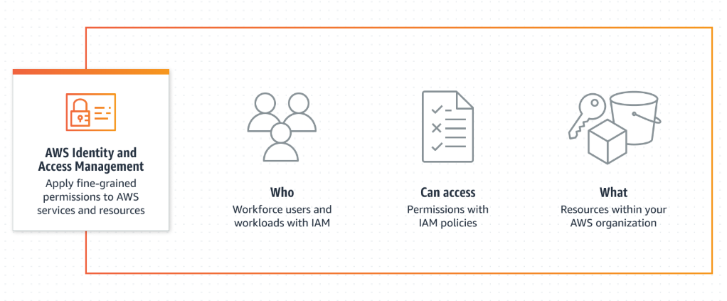
Digital identity & access management : -
i) Digital Identity and Access Management (DIAM) is a system that helps organizations manage and control access to digital resources.
ii) It involves verifying the identity of users, granting appropriate access privelgs, and monitoring user activities.
iii) Identity and Access Management (IAM) is a combination of put policies and technologies that allows organizations to identify users & provide the right form of access as and when required.
iv) The services and resources you want to access can be specified in IAM. It doesn't provide any replica or backup.

Slide 15
Benefits of IAM : -
Save money.
Improve operational efficiency.
Reduce time to deliver application and services.
Enhance Security.
Enhance regulation compliance.
Give more power at audit.

Slide 16
5.6 Content level security : -
1) Content Level Security refers to measures taken to protect the content that is stored, transmitted, or accessed within a system.
ii) It involves implementing various security controls to ensure the confidentiality, integrity, and availability of the content.
iii) This can include encryption, access controls, data loss prevention, and monitoring mechanisms.
iv) The content security levels, from most-permissive to mostrestive are :
1. Read and Write - Content is viewable and editable.
2. Read only - Content is viewable, but cannot be edited.
3. Invisible - Content is not visible.

Slide 17
Need for content level security : -
1. Completely Confidential Content : - Content can be accessed only from some business units. Other units aren’t aware the content.
2. Safety Reuse : - A business unit can share content to other business units but only in read-only mode.
Advantages : -
1. Granular Control.
2. Increased Secuity.
3. Easy to Implement.
Disadvantages : -
1. Performance overhead.
2. Complexity.
3. Risk of overcomplication.
འ་

Slide 18
5.6 security-as-a-cloud service : -
i) Security-as- a-Service (SECaas) is a cloud-based method of outsourcing your cybersecurity.
ii) outsourced security, can cover data protection, database security, and general network security.
iii) All of these can help an organization, combat network threats, such as malware and botnets.
iv) security can be availed by the following alliances : -
- Encryption.
- Network security.
- Email security.
- Identification.
- Data loss prevention.

Slide 19
Benefits of secaas : -
1. Cost Savings : - A cloud delivered service is often available in subscription tiers with several upgrade options so a business only pays for what they need; when they need. It also eliminates the need for expertise.
2. Access to security experts : - with SECaaS, you get experienced, knowledgeable security experts. Whereas, if you use Your in-house team, they may lack specific knowledge.
3. Latest security tools and updates : - with a subscription to a SECaaS provider, you do not have to worry about whether you has the most recent tools and updates because the provider constantly installs the most recent iterations of security software.
4. Faster Provisioning : - with a SECaaS offering, you can scale up or down quickly, deploying security measures according your needs at will.
5. Simpler-in-house management : - with SECaaS, you can manage who has access to which areas of your network and which applications. This way, people can be limited to using only what they need to do their jobs.
6. Free up Resources : - The day-to-day management of cyber- security events and protective measures is taken off your hands, giving your tech professionals more time to help the organization grow.

Slide 20
Examples of Security-as-a-Service : -
1. Data Loss Prevention : - These include tools designed to monitor, protect, and ensure your data is secure. It includes data that is being stored and data that is in use.
2. Continuous Monitoring : - with Secaas, you can continuously A monitor your network and the security tools that have been implemented. on one
3. Disaster Recovery : - In the event of a disaster, SECaaS tools help you get back up and running as soon as possible.
4. Business Continuity : - Business continuity tools keep business- critical systems running even when there is a disaster or other potential interruption.
Services Provided by SECaaS : -
1. Email filtering.
2. Web Content filtering.
3. Vulnerability Management.
4. Identity-as-a-Service (IDaaS).

